Slide 1
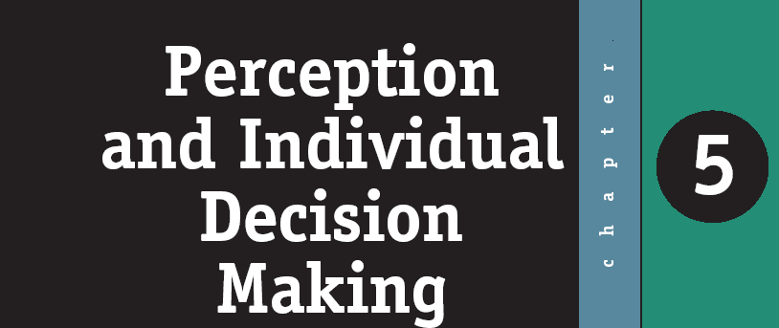
ORGANIZATIONAL BEHAVIOR
W W W . P R E N H A L L . C O M / R O B B I N S
Cdr Vijay Pratap Singh, Adjunct Professor
E&TC Dept, TCET

Slide 2
What is Perception, and Why is It Important?
Perception is a process through which a person forms a point of view or align his mind to follow a fixed impression about any individual, article, environment or idea etc.
People’s behavior is based on their perception of what reality is, not on reality itself.

Slide 3
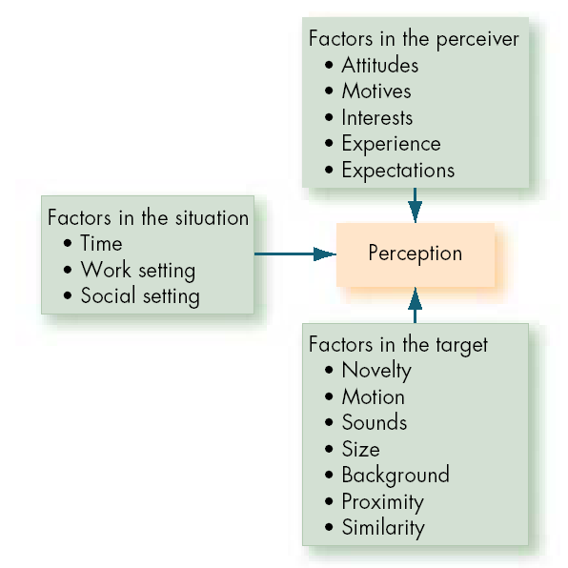
Factors that Influence Perception

Slide 4
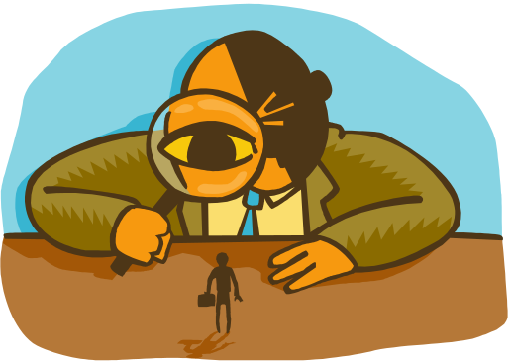
Personal Perception: Making Judgments about others
Attribution theory is concerned with how ordinary people explain the causes of behaviour and events. ... “Attribution theory deals with how the social perceiver uses information to arrive at causal explanations for events. It examines what information is gathered and how it is combined to form a causal judgment”.
03 determinants of Attribution theory:- In making causal attributions, people tend to focus on three factors: consensus, consistency, and distinctiveness.
Consensus: response is the same as others to same situation.
Consistency: responds in the same way over time. Distinctiveness: shows different behaviors in different situations.

Slide 5
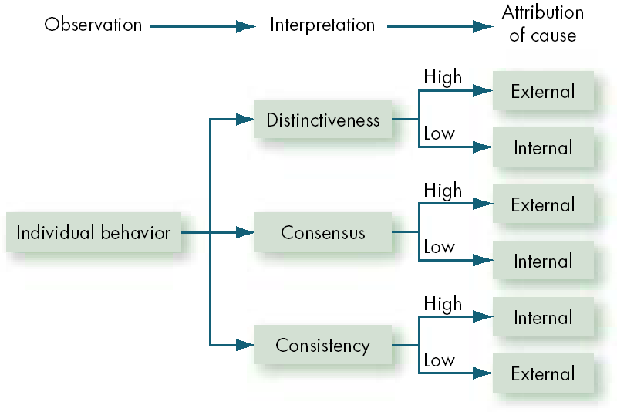
Attribution Theory about Perception

Slide 6
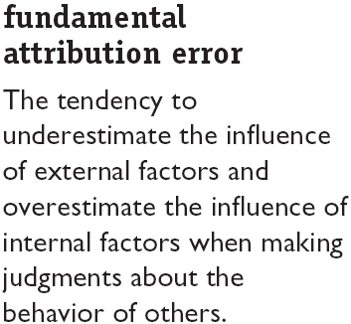

Errors and Biases in Attributions

Slide 7
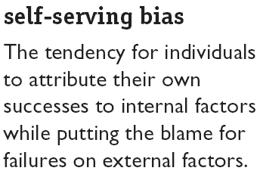

Errors and Biases in Attributions (cont’d)

Slide 8
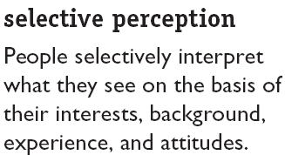
Frequently Used Shortcuts in Judging Others

Slide 9
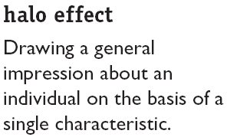

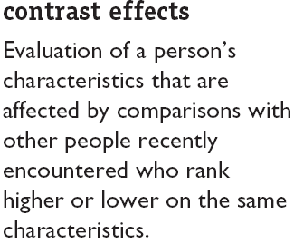
Frequently Used Shortcuts in Judging Others

Slide 10
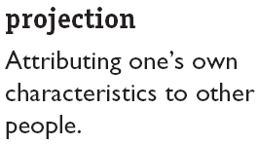
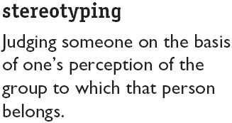

Frequently Used Shortcuts in Judging Others

Slide 11
Examples of biases in Organizations
Employment Interview
  Perceptual biases affect the accuracy of interviewers’ judgments of applicants.
Performance Expectations
  Self-fulfilling prophecy (pygmalion effect): The lower or higher performance of employees reflects pre-conceived leader expectations about employee capabilities.
Performance Evaluations
  Appraisals are subjective perceptions of performance.
Employee Effort
  Assessment of individual effort is a subjective judgment subject to perceptual distortion and bias.

Slide 12
The Link Between Perceptions and Individual Decision Making
Problem
A discrepancy between some current state of affairs and some desired state.
Perceptions of the decision maker
Decisions
The choices made from among two or more alternatives.
Outcomes

Slide 13
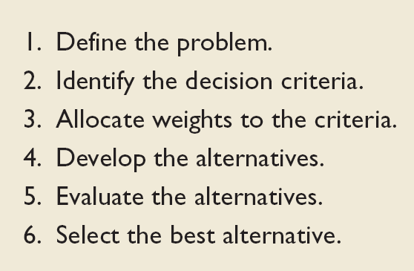
Steps in the Rational Decision-Making Model

Slide 14
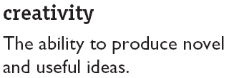
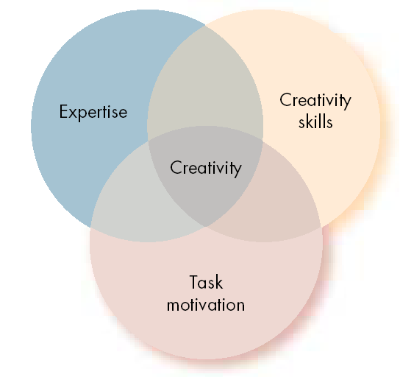
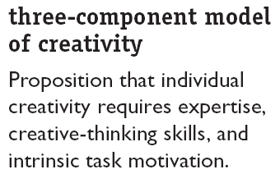
The Three Components of Creativity

Slide 15

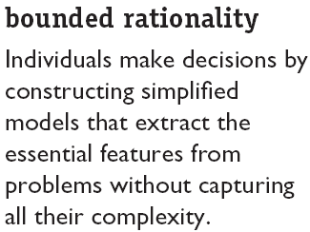

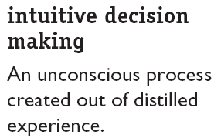
How Are Decisions Actually Made in Organizations

Slide 16
How Are Decisions Actually Made in Organizations (cont’d)
How/Why problems are identified
  Visibility over importance of problem
    Attention-catching, high profile problems
    Desire to “solve problems”
  Self-interest (if problem concerns decision maker)
Alternative Development
  Satisficing: seeking the first alternative that solves problem.
  Engaging in incremental rather than unique problem solving through successive limited comparison of alternatives to the current alternative in effect.

Slide 17
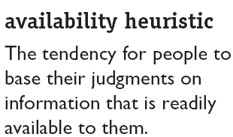

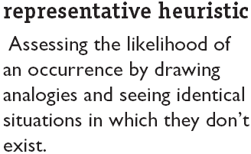
Making Choices
Heuristics
Judgmental shortcuts in decision making

Slide 18
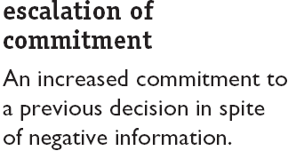

Making Choices

Slide 19
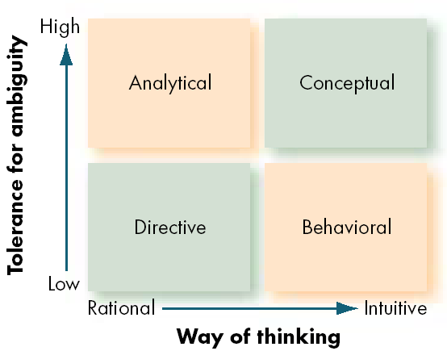
Decision-Style Model

Slide 20
Organizational Constraints on Decision Makers
Performance Evaluation
  Evaluation criteria influence the choice of actions.
Reward Systems
  Decision makers make action choices that are favored by the organization.
Formal Regulations
  Organizational rules and policies limit the alternative choices of decision makers.
System-imposed Time Constraints
  Organizations require decisions by specific deadlines.
Historical Precedents
  Past decisions influence current decisions.

Slide 21

Cultural Differences in Decision Making
Problems selected
Time orientation
Importance of logic and rationality
Belief in the ability of people to solve problems
Preference for collective decision making

Slide 22
Q & A

